Slide 1



KHASAKH CO-OPERATIVE SOCIETY LIMITED

Slide 2
Background
Khasakh is a multi purpose cooperative society that's owned governed and subscribed to former and current world vision, mercy-copes staff, their spouses and children. It's a Christian ﬁnancial institution that extends credit facilities at most competitive interest rates and growing members savings through attractive interest rates.
Our Vision
A Healthy and Wealthy people Centered Financial Institution.
Our Mission
To offer reliable and effective services for healthy and wealthy people.

Slide 3




Objectives
To grow the savings portfolio and members of the cooperative.
To provide affordable financial services to members.
To improve governance, management, accountability and transparency.
To improve organizational accountability and transparency to members.

Slide 4





What we do
We encourage members to develop a saving culture through the available savings products that we offer.
We provide affordable credit services to members-16% per annum
on reducing balance.
We provide free financial services like training members on how to manage their finances for sustainability.
We are responsive as we deliberate in a timely manner.
We are Flexible as the executive committee reserves the right.

Slide 5
Management
We have a Board headed by the chairperson,
Vice chairperson, treasurer, secretary and regional representatives
to oversee operations of the Cooperative.
We also have a supervisory committee which does the supervisory
role to the executive committee. All these board members are
elected at the Annual General Meeting.
Audit is done annually to ensure that proper books of account are
kept and these in turn are displayed at the AGM.
Annual General Meeting is held after the audit exercise.

Slide 6
How to join KHASAKH
Membership is open to all World Vision Uganda staff and their spouses, ex-staff of the Organization and their spouses .
At entry, one fills an entry form indicating personal details and amount to save on a monthly basis. A subscription fee of 30,000Ugx is deducted from the first instalment.
Minimum saving is 50,000Ugx and minimum number of shares at entry are 2 @ 25,000Ugx. A client’s saving is divided by two half to share capital purchase up to 1,600,000/= of shares and the other half to savings.
When all shares are fully purchased and a client has obtained full membership, all his/her remittances are taken back to savings.

Slide 7
SAVING PRODUCTS

Slide 8

Education Saver/ school fees saver
General Saver
Child Saver
Normal saving deposits and earns 5% per annum.
Basically saving for your child / children.
Interest on this is 14% per annum.
Basically for education purposes.
Short Term - earns 5% interest per annum.
Medium term - earns 10% interest per annum.

Slide 9

Target Saver
Pension Saver
Basically encompassing members with
targets like business, construction etc.
Short Term - Interest is 8% per annum.
Medium term -Interest is 10% per annum.
Long term - Interest is 12% per annum.
Accessible after 50 years or 6 months out of formal employment.
Interest is at 12% per annum and it compounds itself annually until maturity of the money on the account.

Slide 10

Access to funds
We have an Online system where one always keeps track of their money and all transactions made on the account.
One can withdraw up to 70% of their money if they don’t have a running loan. withdraws can be done only once in a quarter and withdraw charge of 2,500Ugx.
At closure of account one is given all their savings plus their accumulated interests earned.
Requests for funds can be made online by filling the relevant forms and scanning them back for those that are in the field and then funds are wired to your salary/ preferred account within 3 days.
You can preferably use our bank accounts in the names of Khasakh cooperative savings and credit society limited;
0102011573400 -Standard Chartered bank
3100059233 - Centenary bank.
Mobile money 0703 894 550 -Baluka Rebecca

Slide 11
LOAN PRODUCTS
z

Slide 12


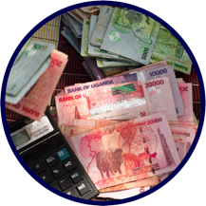
Processed within 24 hours.
Take up to 1 million.
Maximum payment period is 1 month.
10% interest per month.
Kagwilawo/
Express Loan
Maximum 5,000,000Ugx, interest rate of 2.5% (flat) per month.
Payable within a maximum of 6 months from the date of disbursement.
The short term Loan installments are deducted after about 30 days from salary from the date it was advanced.
Short term
loans
One can access a maximum of Savings x2, shares x3 + net pay.
Processing fee for loans below 5 million is 30,000Ugx.
Processing fees for loans that are 5million and above is 60,000Ugx.
Interest rate is 16% per annum and on reducing balance.
Salary loans

Slide 13



One can also use their land title as security to access up to a maximum of 200,000,000Ugx. The repayment period does not exceed 5 years (60 months).
Interest on loans is 16% per annum on reducing balance.
Land Loans
This applies to members who wish to acquire assets and services such as land, vehicle, building construction etc.
With this loan, an asset is co-financed by the member and the Sacco.
The member should have at least 20% of the total cost of the asset in cash while 80% is covered by the SACCO after full verification and search has been done.
All these loans are at an interest rate of 16% reducing balance.
Asset Finance
Loan
Khasakh also offers group loans to its clients in order to help them achieve a group target.
The group must be registered and have been in existence for at least 6 months.
Proof of group performance in terms of income and expenditure must also be availed.
Interest rate is at 16% per annum reducing balance.
Group Loans

Slide 14

Khasakh offers its clients an option of buying off their bank loans swiftly.
Your bank loan must have been well serviced for at least the last 6 months.
Loan repayment agreements are fully agreed upon before buying of the bank loan.
Bank Loans
Investments
The SACCO is currently investing in loans, fixed deposits, treasury bills, real estates etc.
https://www.youtube.com/watch?v=Rk3ABPSE64g

Slide 15

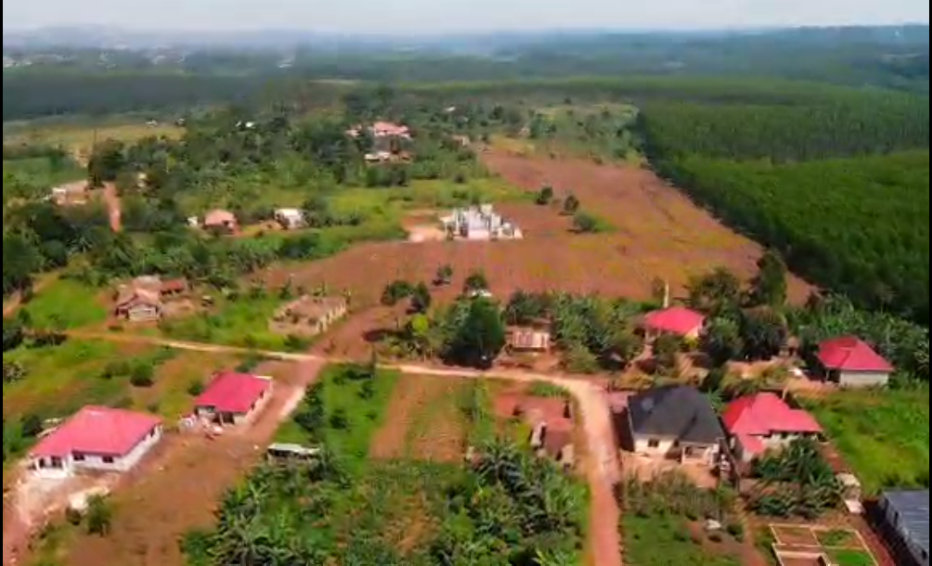
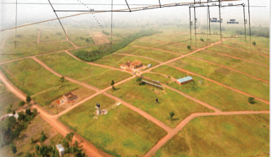
Real Estate Projects
Sold out
Each plot was sold 27Million to members and
30M to non members
Gayaza Kiwenda
Located in Kisowera Mukono 7km from Mukono town.
Sold at 22m to Sacco members and 26m to non members.
10 of 38 plots of land are remaining balance available for grabs.
Mukono Nkooki
Matugga sanga
Coming soon

Slide 16


Contacts
Naiga Josephine Musisi,
Manager
0700878176
jnaiga@khasakh.com
Baluka Rebecca,
Accountant
0703 894 550
rebecca_baluka@wvi.org
Copy: info@khasakh.com
khasakhcare@gmail.com

Slide 17
THANK YOU
Q&A’s

